Slide 1
Yp’s Tracker

Slide 2
ABOUT US
"At Capgemini , we envision a future where young professionals thrive in a dynamic and innovative work environment."

Slide 3
User Interface
User Authentication:
Login:
  Implement a secure login system.
  Check if connected to office Wi-Fi; if not, require Ping ID for authentication.
Task Management:
Dashboard:
  Display total tasks, completed tasks, and overdue tasks.
  List all tasks on the dashboard.
Tasks:
  Display task name, due date, completion date, priority, and status.
Due Dates and Reminders:
  Integrate with Outlook calendar for task reminders.
  Set up pop-ups for today's tasks.
Certifications and Learning:
Certifications:
  Allow users to upload completed certifications.
YouTube Tracking:
  Implement a user authentication system on your website.
  Integrate YouTube API to track videos watched.
  Track time spent watching videos.
Attachments and Coding Practice:
Attachments:
  Allow users to upload documents and images.
Coding Practice:
  Provide daily coding challenges.
  Create pages to check completed tasks, overdue tasks, and code submissions.
Reports and Rewards:
Reports:
  Generate daily, weekly, and monthly reports.
Rewards:
  Implement a points system for user achievements.
  Reward users based on their performance and completion rates.
Attendance and Absence:
Attendance:
  Mark days when the user is absent.

Slide 4
Admin INTERFACE
User Performance Monitoring:
  Display charts and graphs for user performance metrics.
Reports and Analytics:
  Provide detailed reports on individual users.
  Analyze task completion trends over time.
User Account Management:
  Allow admins to add, edit, or deactivate user accounts.
  Implement user role management.
Feedback System:
  Set up an automated system to send messages to inactive users.
  Encourage engagement and collect feedback.
Filtering and Sorting:
  Allow admins to filter users based on different criteria.
  Implement sorting options for users.
Admin User Management:
  Enable the addition of new administrators.
  Manage admin roles and permissions.

Slide 5
APPLICATION OVERVIEW
Connectivity
YouTube Tracking
Connection to the Office WiFi is required for seamless login.
In the absence of Office WiFi, a Ping ID will be necessary for secure login to the application
User authentication to monitor YouTube video watching habits.
Integration with YouTube API for tracking specific time spent (e.g., 5 or 6 hours).
Yps Tasks Dashboard:
Coding Practice
Key metrics displayed: Total Tasks, Completed Tasks, and Overdue Tasks.
Homepage functionality: Lists all tasks for quick reference.
Daily provision of 4 alternative codes based on user domain.
Separate pages for task completion and overdue checks, including attachment of previous programs.

Slide 6



PRODUCT BENEFITS
Enhanced Productivity
Learning and Skill Development
Scalability and Adaptability

Slide 7
GROWTH STRATEGY
How we’ll scale in the future
User Recognition:
Personalized Content:
Interactive Learning:
Implement a leaderboard or recognition system for users who consistently perform well or achieve milestones.
Implement algorithms for personalized content delivery based on user preferences, learning history, and task completion.
Introduce gamification elements to make learning and task completion more engaging.

Slide 8
SUMMARY
Our project is a comprehensive Learning and Task Management Platform designed to streamline the educational and professional development journey for Young Professionals (YP). The platform offers a wide array of features tailored to enhance task management, skill acquisition, and user analytics."

Slide 9
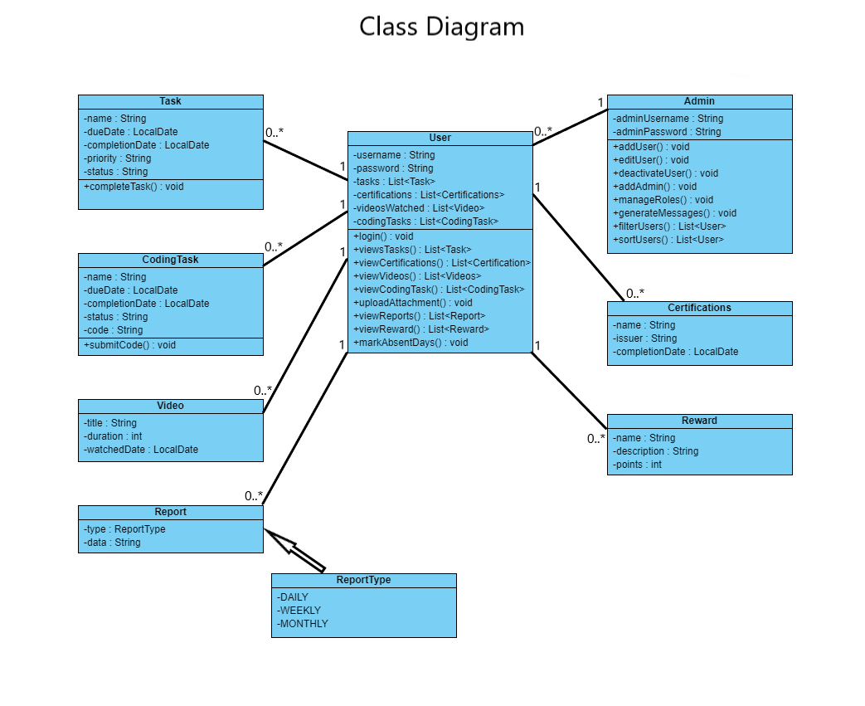

Slide 10
THANK YOU

